Slide 1
SLAM: Knowing Your Surroundings
EE483 Final
Nathan Rihani, Forrest Steele, Paul Allen, Shih-Jie Shih

Slide 2


Scenario: Duckietown can’t navigate!
WAZE and other GPS have been hacked by a group of geese
These APPS are causing Mallard Mobiles to drive into other cars, off cliffs, and into Duckietown O-Block.
Now the duckies are too afraid to drive with GPS but need a navigation system of some sort!
Notes:
Forrest

Slide 3
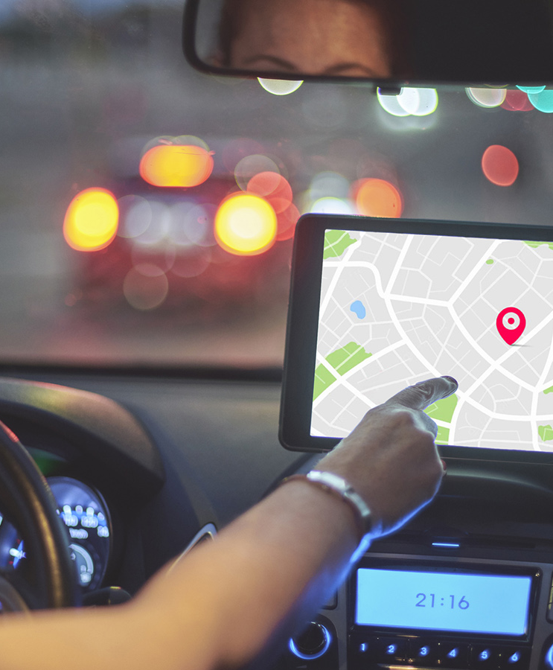
Problem Statement
Modern society’s navigation systems (i.e., GPS) are very dependent on volatile factors
Satellites
Foreknowledge of an area’s mapping
Consistency
Etc.
This works fine until any one of those factors fail
We need to be able to sense, map, and navigate areas in real time without these factors
Notes:
Forrest

Slide 4

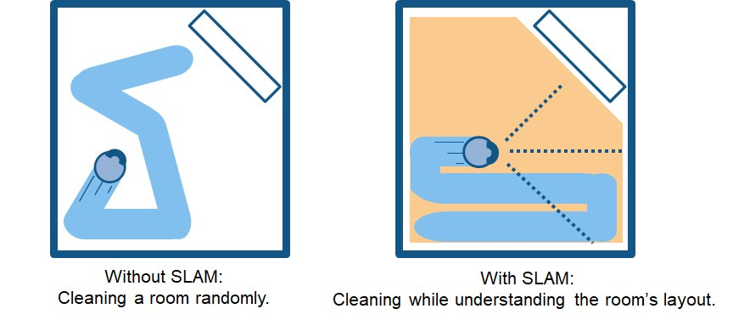
Introducing SLAM
SLAM algorithms allow for robots to autonomously map their location and environment
Traditional mapping tools, such as GPS and satellite imagery, are poorly suited for indoor or dynamic settings due to limited signal access, lack of real-time updates, and inability to capture fine-grained details
SLAM uses either camera or sensors to take in data and plot it using odometry
SLAM is used in robots such as self-driving cars and autonomous home vacuums
Notes:
Forrest

Slide 5
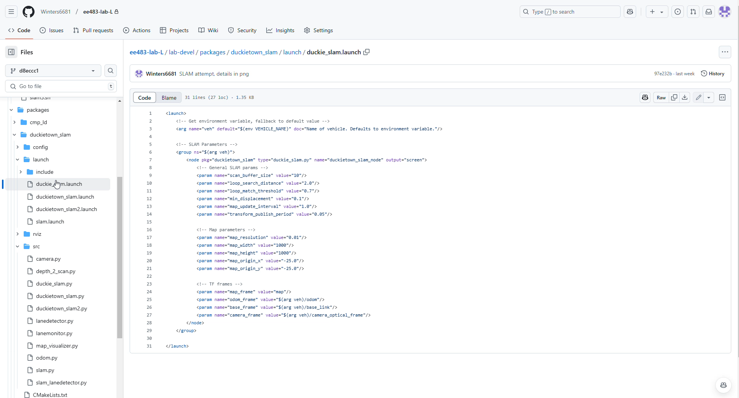
Implement SLAM
Notes:
Winters

Slide 6
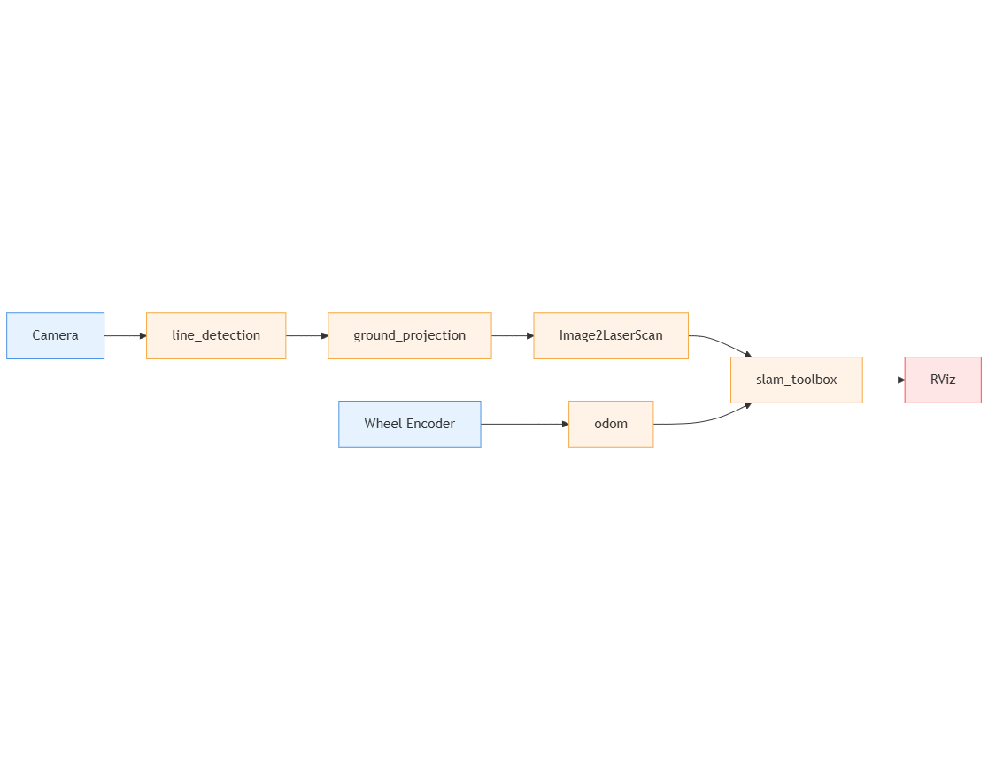
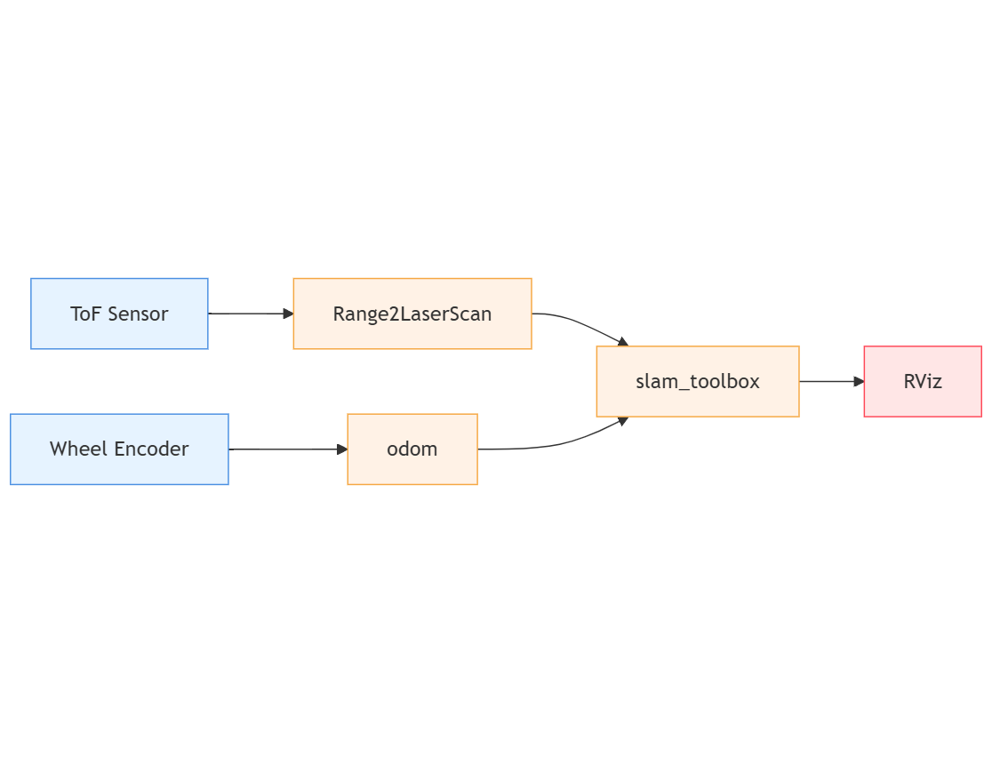
Implement SLAM
10+ hours
10+ hours
Professor helping out!
Notes:
Winters

Slide 7
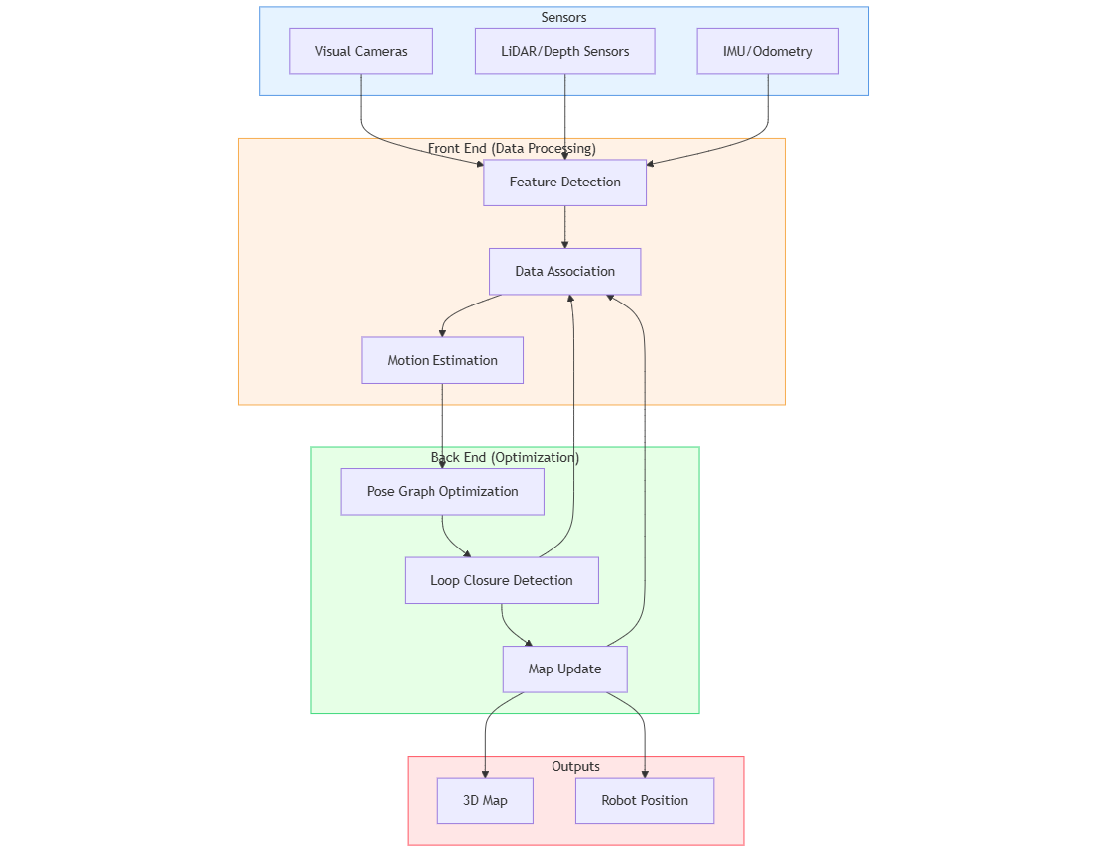
Implement SLAM
Notes:
Winters

Slide 8
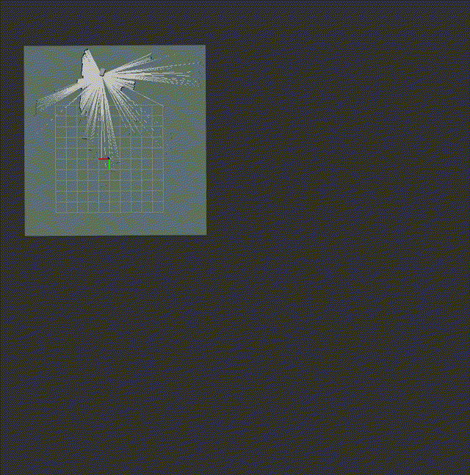
Implement SLAM
Notes:
Winters

Slide 9
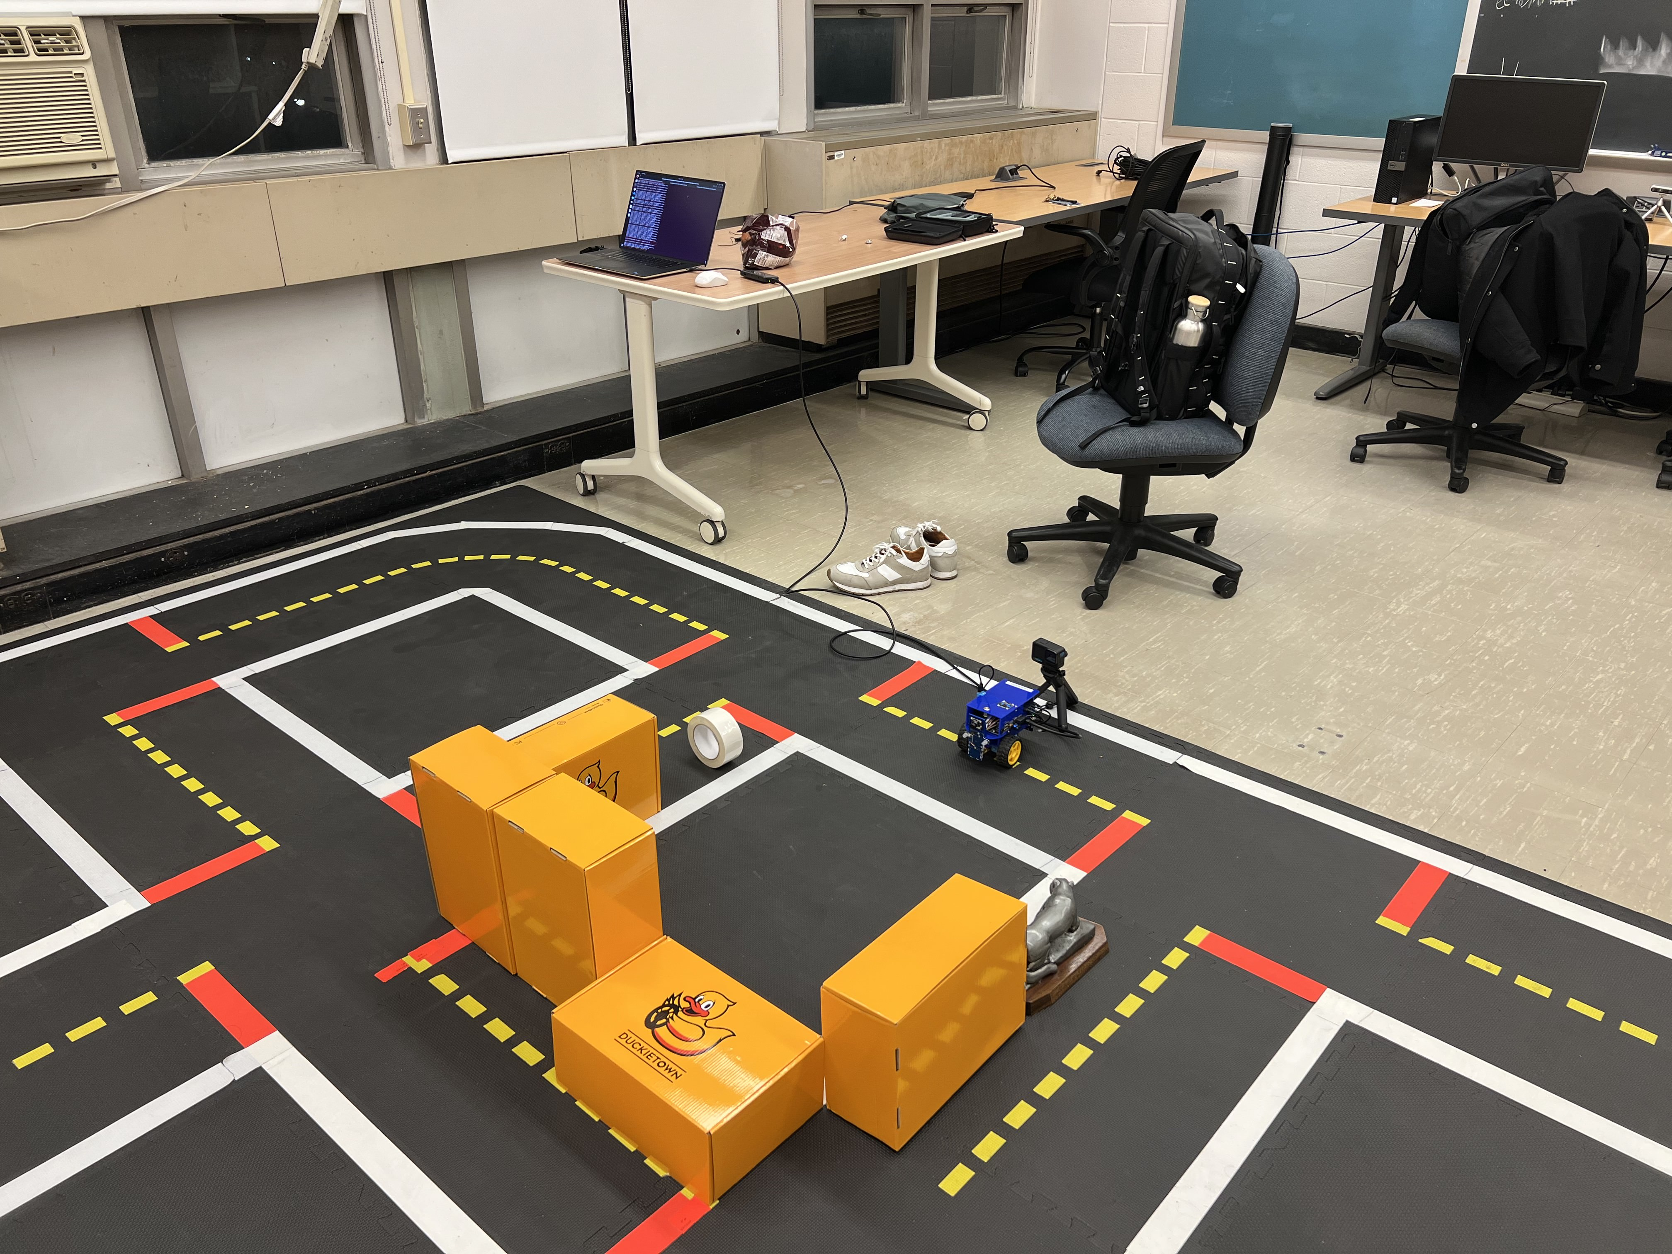
Implement SLAM
Notes:
Winters

Slide 10
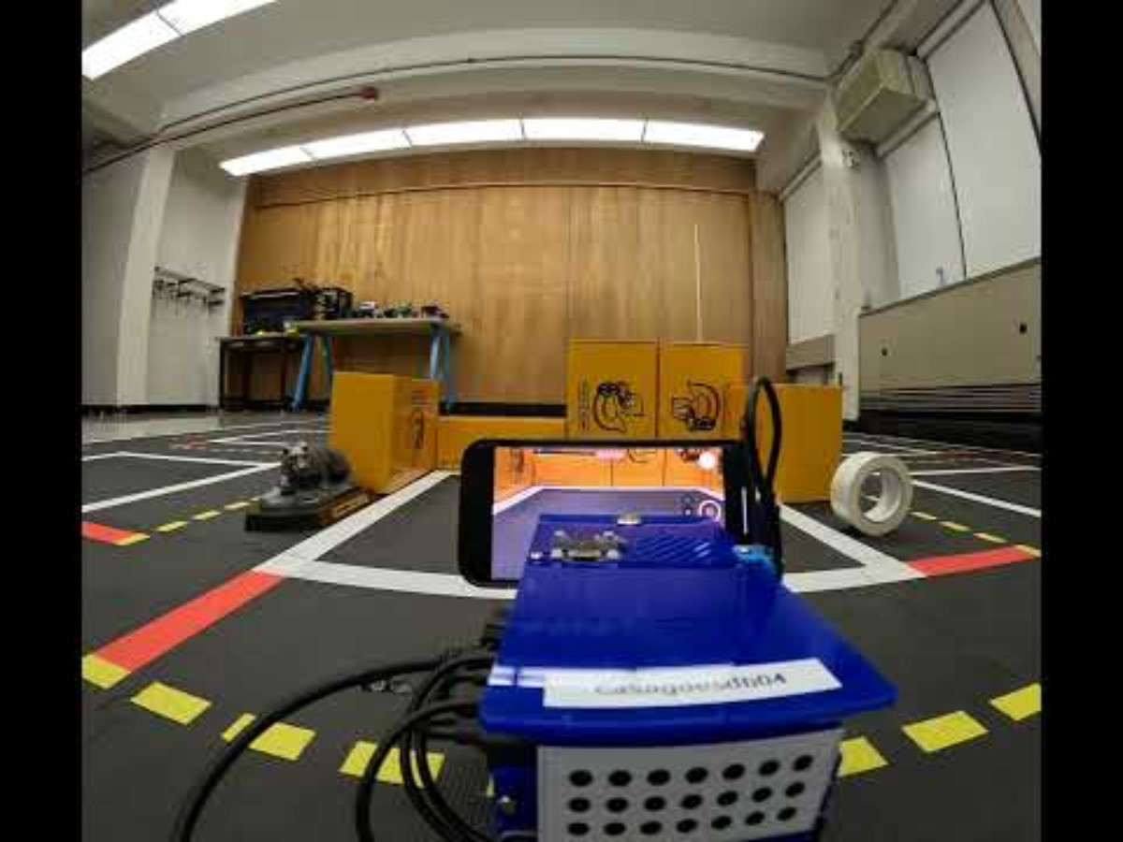
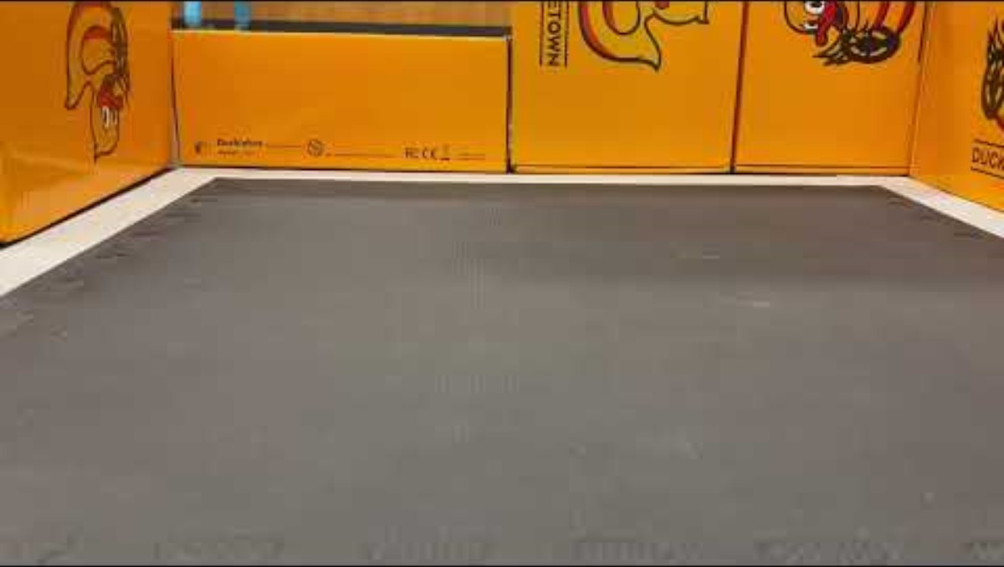
Notes:
Winters

Slide 11
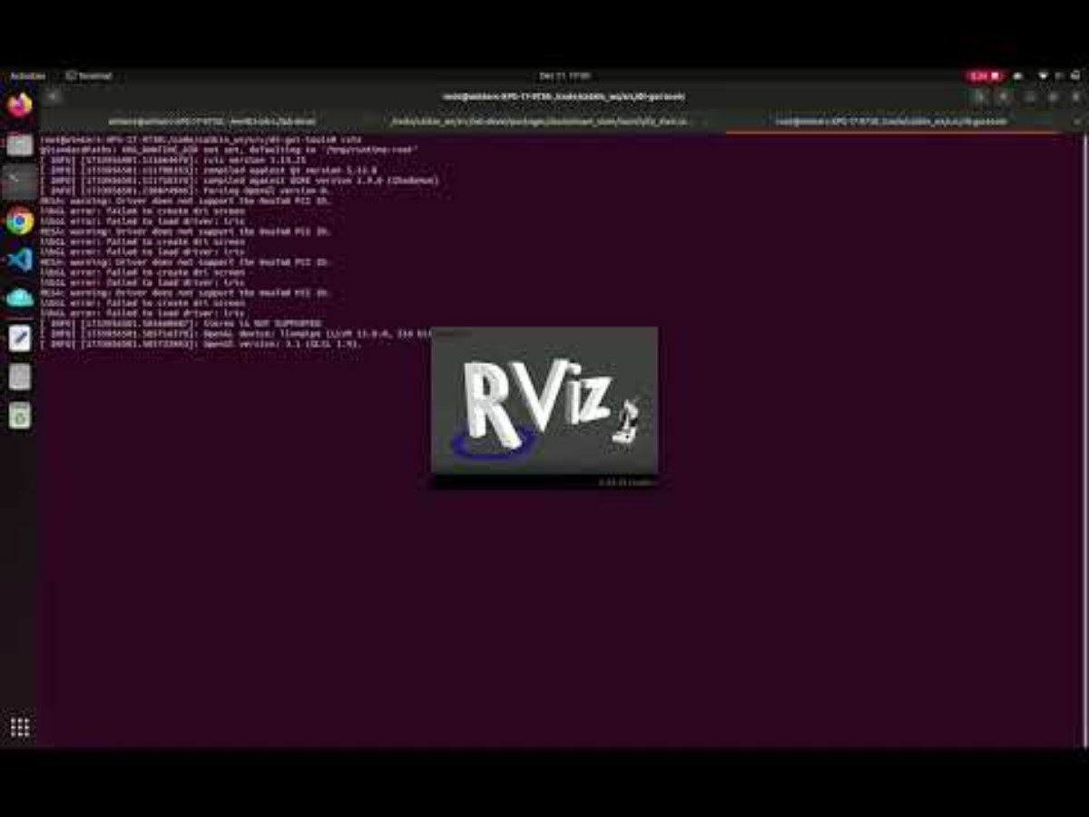
Notes:
Winters

Slide 12
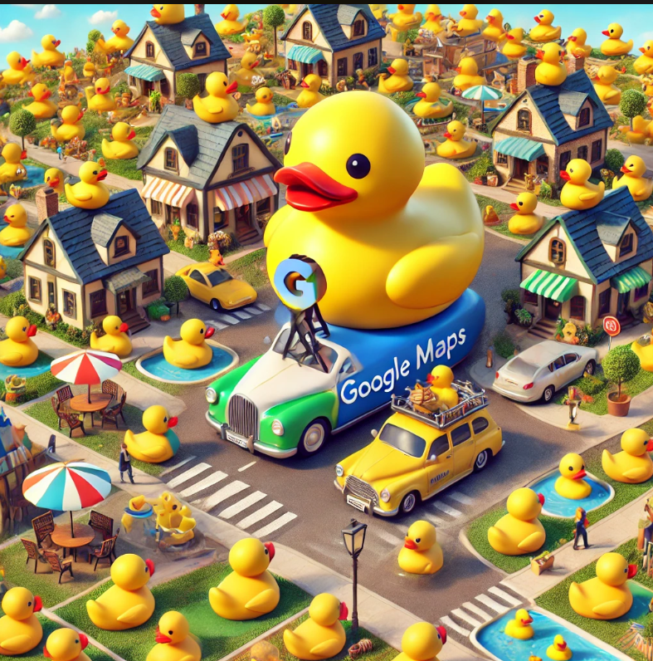
Ideas for Expansion
Duckie Maps
As the mallard mobile travels though Duckietown the robot could take pictures
Placing these pictures along the map give a more in-depth view of the city
Path Finding
Other entrepreneurs are trying to integrate autonomous navigation
Our map could be used as the foundation for that
Our map could also include directions for lanes, could expand our maps to include one ways and more realistic road patterns

Slide 13
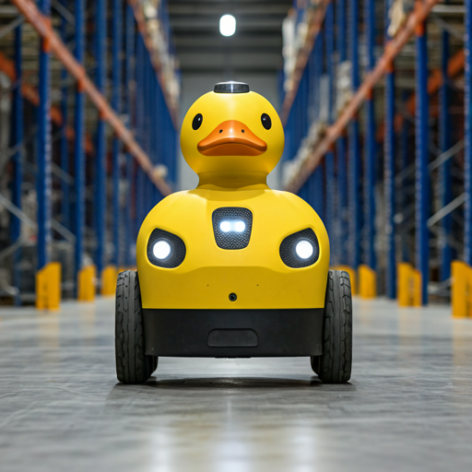
Applications
Remapping of dynamic environments
Traffic control and sensing other cars
Autonomous industrial manufacturing (mapping out an assembly area)
Indoor applications
Mapping uncharted or dangerous areas such as war zones or areas affected by natural disaster, where GPS/Sat. imaging might not be available
Disability assistance (mapping surroundings for blind people)

Slide 14

Implications
Legal:
Privacy- Is it lawful in Duckietown to map privately owned buildings without a Duckie’s consent?
Liability- When do we pin the responsibility on the driver vs the mapping system in cases of damage or injury?
Social:
Traffic- Duckies may opt to take different routes like neighborhoods now that they’re mapped
Environment- Duckies may perceive their environment differently based on insights mapping might provide

